Slide 1
Programming Fundamentals
Lecture No. 02

Slide 2
What Will You Learn Today?
Variables
Keywords in C++
Data Types
Operators
Precedence of Operators
Assignment Operator
2

Slide 3
Programming in C++
Output
C++ Code
Compiler
Error Messages
3

Slide 4
Sample Program
Preprocessor Directive
#include<iostream>
using namespace std;
int main()
{
cout << "Hello World!";
}
Namespace
Main Function
4

Slide 5
First Program
Programs in C++ are written in blocks
Every block has name
The name of monitor block is main
Every statement is ended with semi-colon (;)
Our first program will display a message on output screen
Output of the Program
Hello World
5

Slide 6
Variables
A variable is a location in computer memory where a value can be stored
Variables must be declared before they are used in a program
In a program a variable has:
Data Type
Name
Size
Value
6

Slide 7
Variable Names
Following rules should follow for naming the variables:
Upper case letters
Lower case letters
Digits (0 to 9)
Underscore (Not Recommended)
Keywords can’t be used as variable name i.e. return, int, void etc.
7

Slide 8
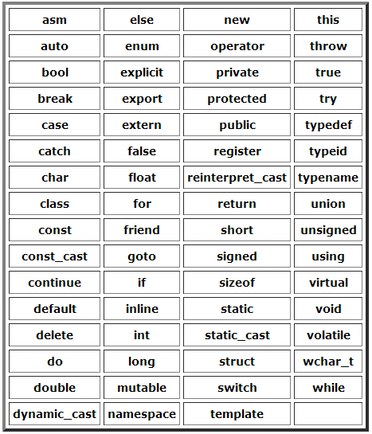
Keywords in C++
8

Slide 9
Variable Names
C++ is a case sensitive language: number is different from Number or nUmber
Valid identifiers:
int abc, char aBc, int first_var, float _first
Invalid identifiers:
int 3bc, int a*b, int #a, int void
9

Slide 10

Variable Naming Conventions
camelCase variable names:
number, firstName, dateOfBirth
PascalCase variable names
Number, FirstName, DateOfBirth
Rule of Thumb
Use camelCase for variable names
Use PascalCase for advanced naming e.g. Classes, functions
10

Slide 11
Variables Names – Examples
int firstNumber;
char gender = 'm';
float piValue = 3.14;
int myAge, int countryName;
int a, b, c;
11

Slide 12
Data Types
Keyword | Range |  | Bytes of Memory
 | Low | High
char | -128 | 127 | 1
short | -32,768 | 32768 | 2
int | -2,147,483,648 | 2,147,483,647 | 4
long | -2,147,483,648 | 2,147,483,647 | 4
float | 3.4*10-³⁸ | 3.4*10³⁸ | 4
double | 1.7*10-³⁰⁸ | 1.7*10³⁰⁸ | 8
long double | 3.4*10-⁴⁹³² | 3.4*10⁴⁹³² | 10
12

Slide 13
Data Types
Keyword | Range |  | Bytes of Memory
 | Low | High
unsigned char | 0 | 256 | 1
unsigned short | 0 | 65535 | 2
unsigned int | 0 | 4,294,967,295 | 4
unsigned long | 0 | 2,147,483,647 | 4
13

Slide 14
Arithmetic Operators
C++ Operation | Arithmetic Operator
Addition | +
Subtraction | -
Multiplication | *
Division | /
Modulus | %
14

Slide 15
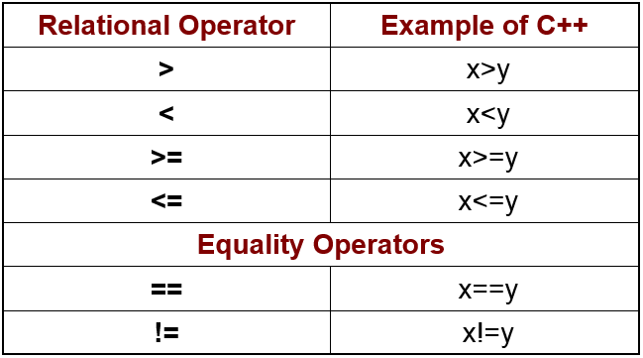
Relational Operators
15

Slide 16
Arithmetic Operators – Examples
Arithmetic Operators
firtNo + secondNo ;
firstValue * secondValue ;
dividend / divisor ;
dividend % divisor ;
% = Remainder
15 % 2 = 1
20 % 5 = 0
38 % 6 = ?
16

Slide 17
Precedence of Operators
Highest: ( )
Next: * , / , %
Lowest: + , -
17

Slide 18
Same Precedence
For addition, subtraction, division and multiplication → Left-to-right rule applies
A+B+C = (A+B)+C
For exponentiation → Right-to-left rule applies
A ↑ B ↑ C = A ↑ ( B ↑ C )
18

Slide 19
Quadratic Equation
In algebra
Quadratic = ax² + bx + c
In C++
Quadratic = a*x*x + b*x + c
19

Slide 20
Activity
10+2*3+5*4+12/6+5*20/2
88
20

Slide 21
Activity
5 *4+16/16+5*2
5 *4+16/(16+5*2)
Equal???
21

Slide 22
Assignment Operator
=
A = 20
A
20
22

Slide 23
Assignment Operator
X
5
X = 5 ;
X = 10 ;
X
10
23

Slide 24


Assignment Operator
L.H.S = R.H.S
a + 2 = b + 10
z = x + 4
a + 14 = m
24

Slide 25
Recap
Variables
Keywords in C++
Data Types
Operators
Precedence of Operators
Assignment Operator
25

Slide 26

Questions
26

